Slide 1
IC Bertacchi Busto Arsizio . VA Scuola Secondaria di Primo Grado Bellotti CLIL ITALY LET’S TALK ABOUT IT! From Monnalisa to Marilyn Be creative with technology! Progetto CLIL di Arte e Storia dell’Arte di Michela Marcellino

Slide 2
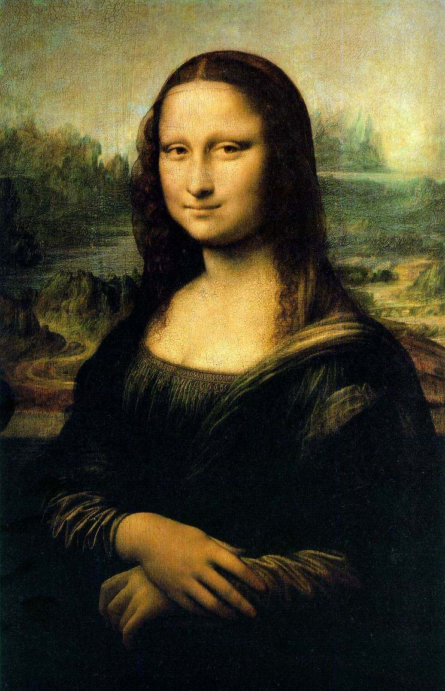
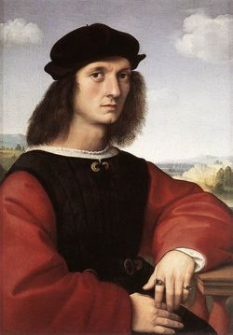
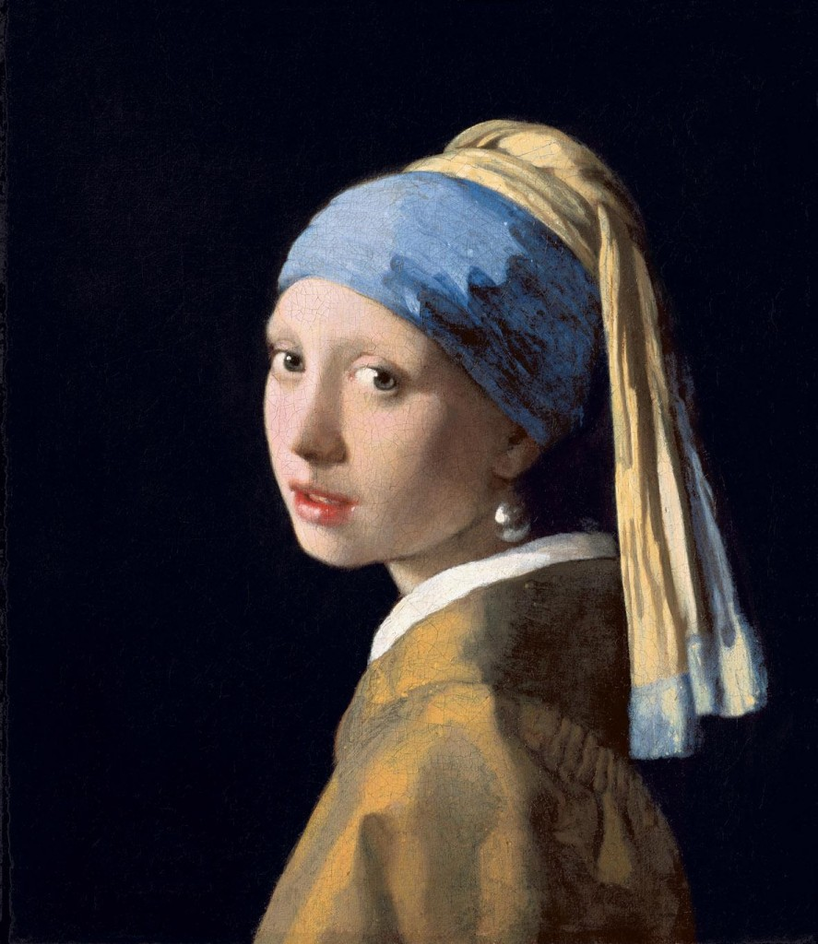
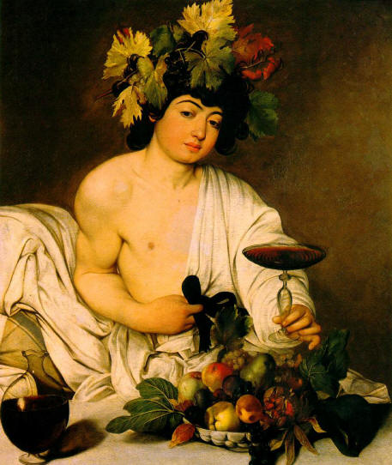
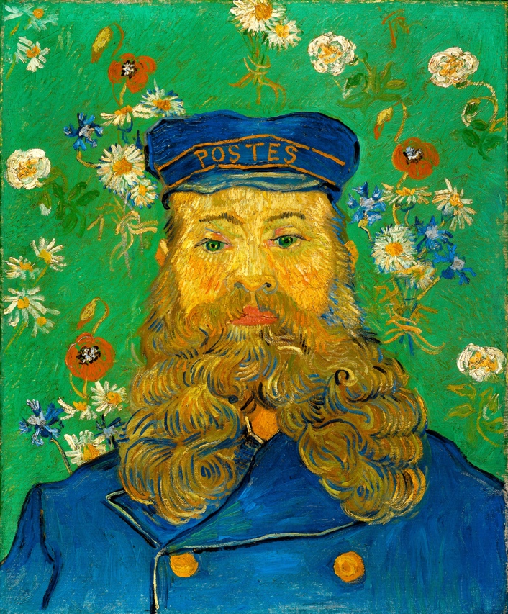
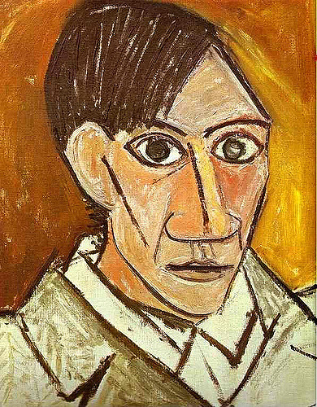
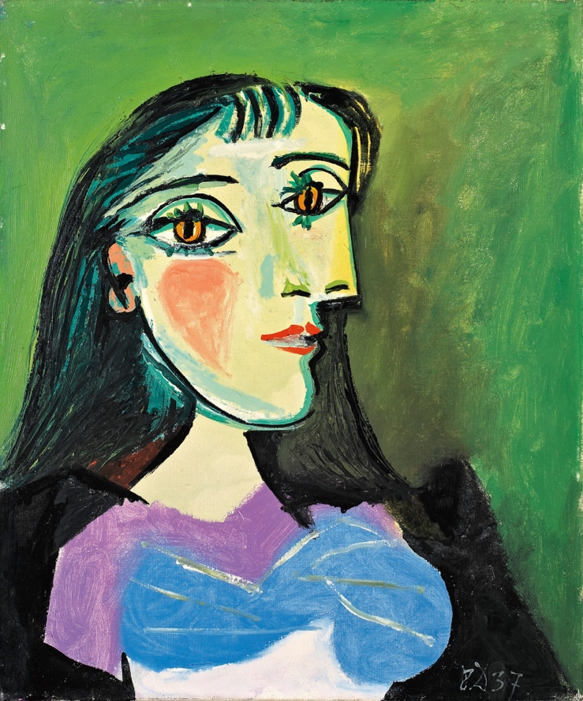
From Monnalisa to Marilyn
Typology of Portraits
REALISTIC
REALISTIC
REALISTIC
IDEALIZED
BE CREATIVE WITH TECHNOLOGY!
INVENTED
ABSTRACT
PLAY NOW!
INVENTED
IDEALIZED

Slide 3
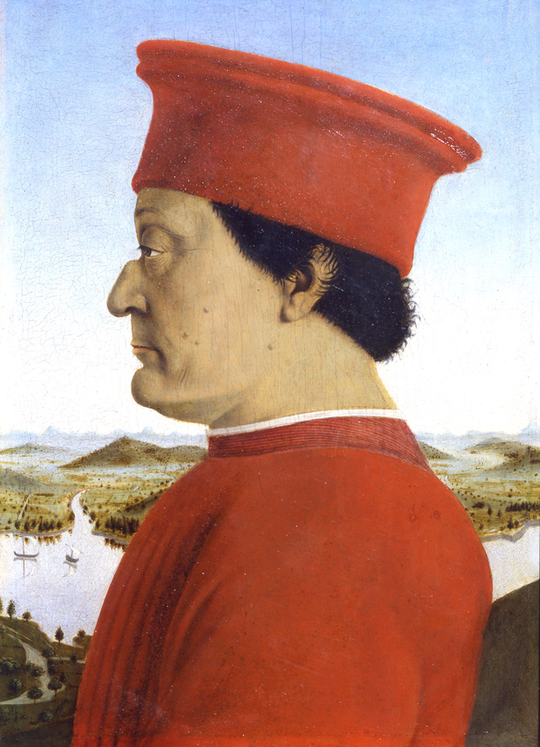
The Painter can draw the model from different angles
A FRONT VIEW
A PROFILE
A THREE QUARTER VIEW
PLAY AGAIN!

Slide 4
The subject of a PORTRAIT is the model
Portraits usually look like the models and are very similar to their real aspects
These kinds of portraits are called REALISTIC
When portraits do not look like the models, they are called ABSTRACT

Slide 5
Typology of Portraits
REALISTIC
REALISTIC
REALISTIC
IDEALIZED
INVENTED
ABSTRACT
INVENTED
IDEALIZED

Slide 6
The painting, thought to be a portrait of LISA GHERARDINI, the wife of Francesco del Giocondo.
Leonardo da Vinci began painting the Mona Lisa in 1503 or 1504 in Florence, Italy.
Many people think Mona Lisa's smile is mysterious and enigmatic.
Background
Landscape
Aerial Perspective
Foreground
Three quarter view Hands folded
Leonardo Da Vinci The Monna Lisa
1503-1506 – Oil on wood panel
Louvre, Paris - France

Slide 7
QUESTIONS…
WHAT DOES IT MEAN?
CAN YOU REPEAT IT PLEASE?
PUT THE MISSING WORD
WHAT DO YOU THINK OF IT?
WHY IS….?
WHAT DO YOU FEEL?
WHAT IS HAPPENING?
WHAT CAN YOU SEE?
CAN YOU DESCRIBE?
WHY DO YOU SEE YOURSELF LIKE THAT?
LET ME SEE
POINT - SHOW

Slide 8
Adjectives
Kind
Soft
Delicate
Beautiful
Ugly
Bright
Bored
Smiling - to Smile
Sad
Weeping - to Cry
Serious
Mysterious
Enigmatic
Detached
Complex
Harsh
Angry
Cruel
Nervous
Relaxed
Simple
Complete - un finished

Slide 9
Artistic Techniques
Oil on canvas
Oil on wood panel
Drawing
Sketch
Frescos
Watercolours
Collage
Paper mache
Serigraphy
Sculpture: Clay, Marble, Bronze

Slide 10
Materials
Canvas
Palettes
Paints
Brushes
Pencils
Pens
Rubber – Putty
Pencil Sharpener
Scissors
Glue
Ruler
Compass
Drawing Sheet - Rough Paper - Smouth paper
Cardstock -Cardboard
Ink
Watercolours

Slide 11
Different Background
WHAT CAN YOU SEE?
CAN YOU DESCRIBE?
Jan Vermeer Girl with a Pearl Earing
1503 - Oil on canvas
Mauritshuis - Netherlands
Leonardo Da Vinci The Monna Lisa
1503 -1506 - Oil on wood panel
Louvre, Paris

Slide 12
Similar Position: Three quarter view - Hands folded
WHAT CAN YOU SEE?
WHAT DOES IT MEAN?
Leonardo Da Vinci The Monna Lisa
1503-1506 - Oil on wood panel
Louvre, Paris
Raffaello Sanzio Maddalena’s Strozzi portrait
1506 - Oil on wood panel
Palatina Gallery, Florence

Slide 13
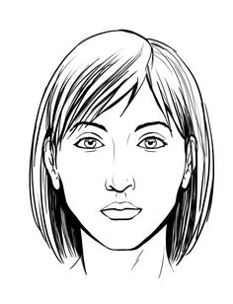
Head and Face
PUT THE MISSING WORD
Long Hair
CAN YOU REPEAT IT PLEASE?
Eye brows
Eye
Ear
Cheek
Nose
Lip
Nostrils
Mouth
Chin
Neck

Slide 14
Head and Face
PUT THE MISSING WORD
CAN YOU REPEAT IT PLEASE?
Short Hair
Moustache
Shoulders
Beard

Slide 15
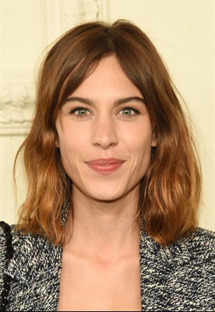
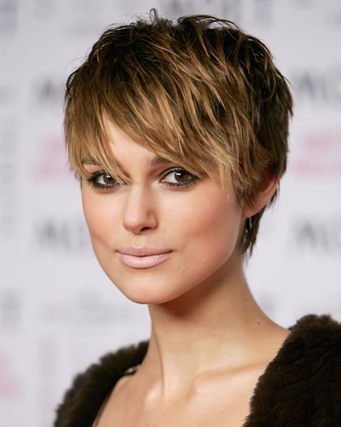
PUT THE MISSING WORD
Curly
Wavy
CAN YOU REPEAT IT PLEASE?
Straight
Long
Short

