Slide 1
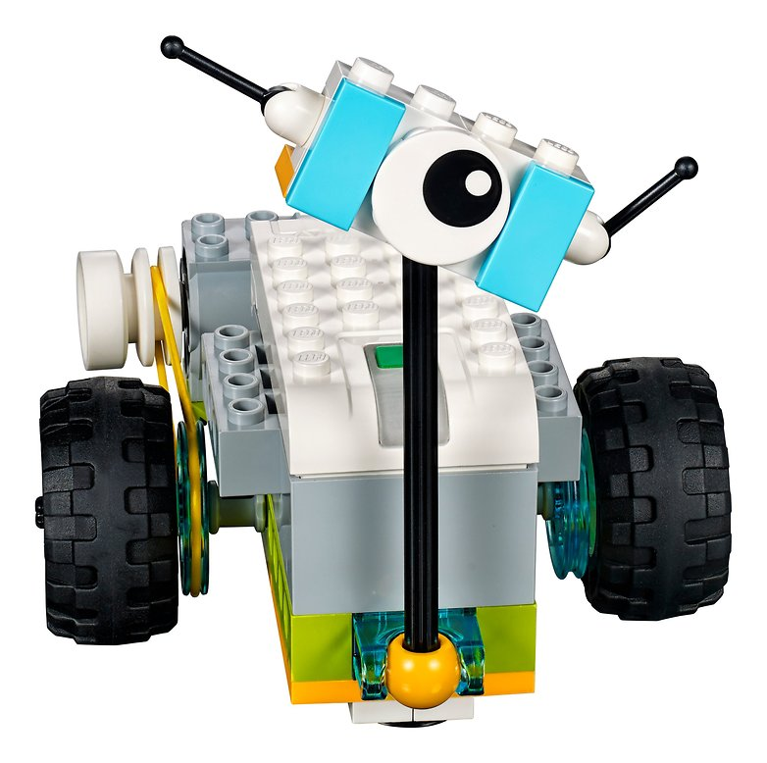
Milo, the science rover

Slide 2
BUILDing MILO …
SOME ACTIONS
MILO’S COMPONENTS
CONNECT MILO TO THE IPAD THROUGH A BLUETOOTH CONNECTION
DRUG
DROP
PUSH
OPEN
CONNECT
BRICKS
ANTENNAS

Slide 3
WHAT CAN MILO DO? IT CAN …
Think
Reload
Speak
Change colour
Change frequency
Stop
Take picture
Turn right
Turn left
Move forward
Move backward
Switch on/off the lights

Slide 4
MILO’S HABITAT: The UNIVERSE
the Universe
galaxy
space
planet
satellite
star
eclipse
asteroid
comet
the Milky Way
the Asteroid Belt

Slide 5
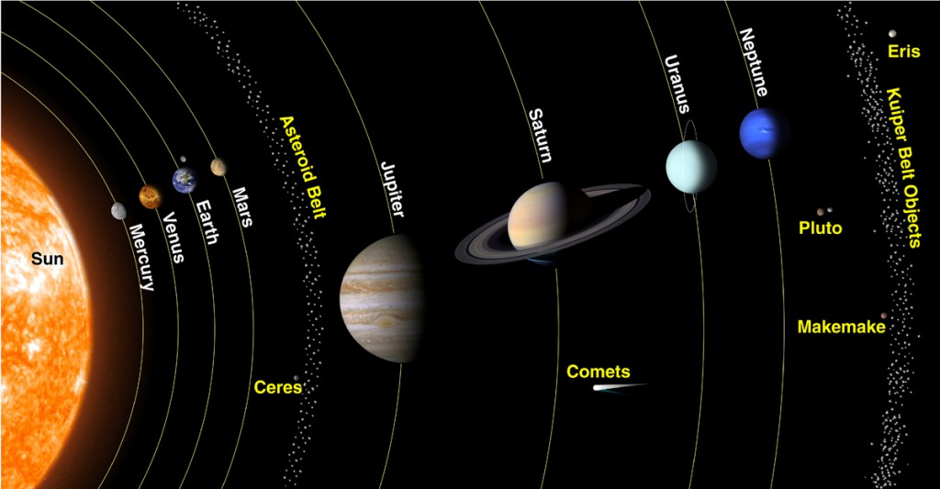
The Solar System

Slide 6
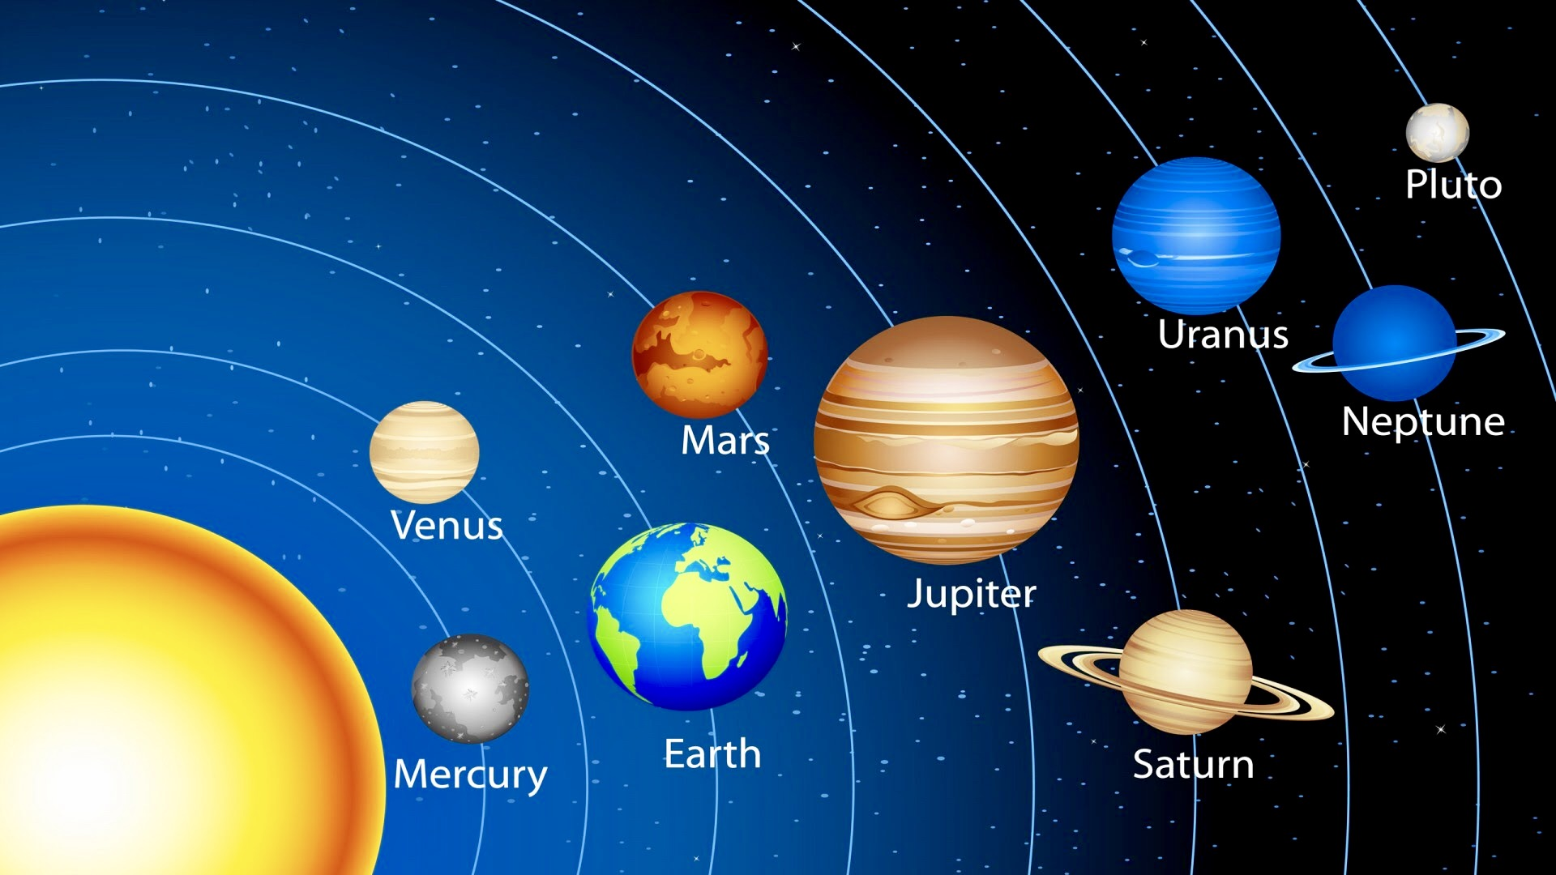
The Solar System

Slide 7
The Solar System
the Sun
Mercury
Venus
the Earth
the Moon
Mars
Jupiter
Saturn
Uranus
Neptune
Pluto

Slide 8
The sun

Slide 9
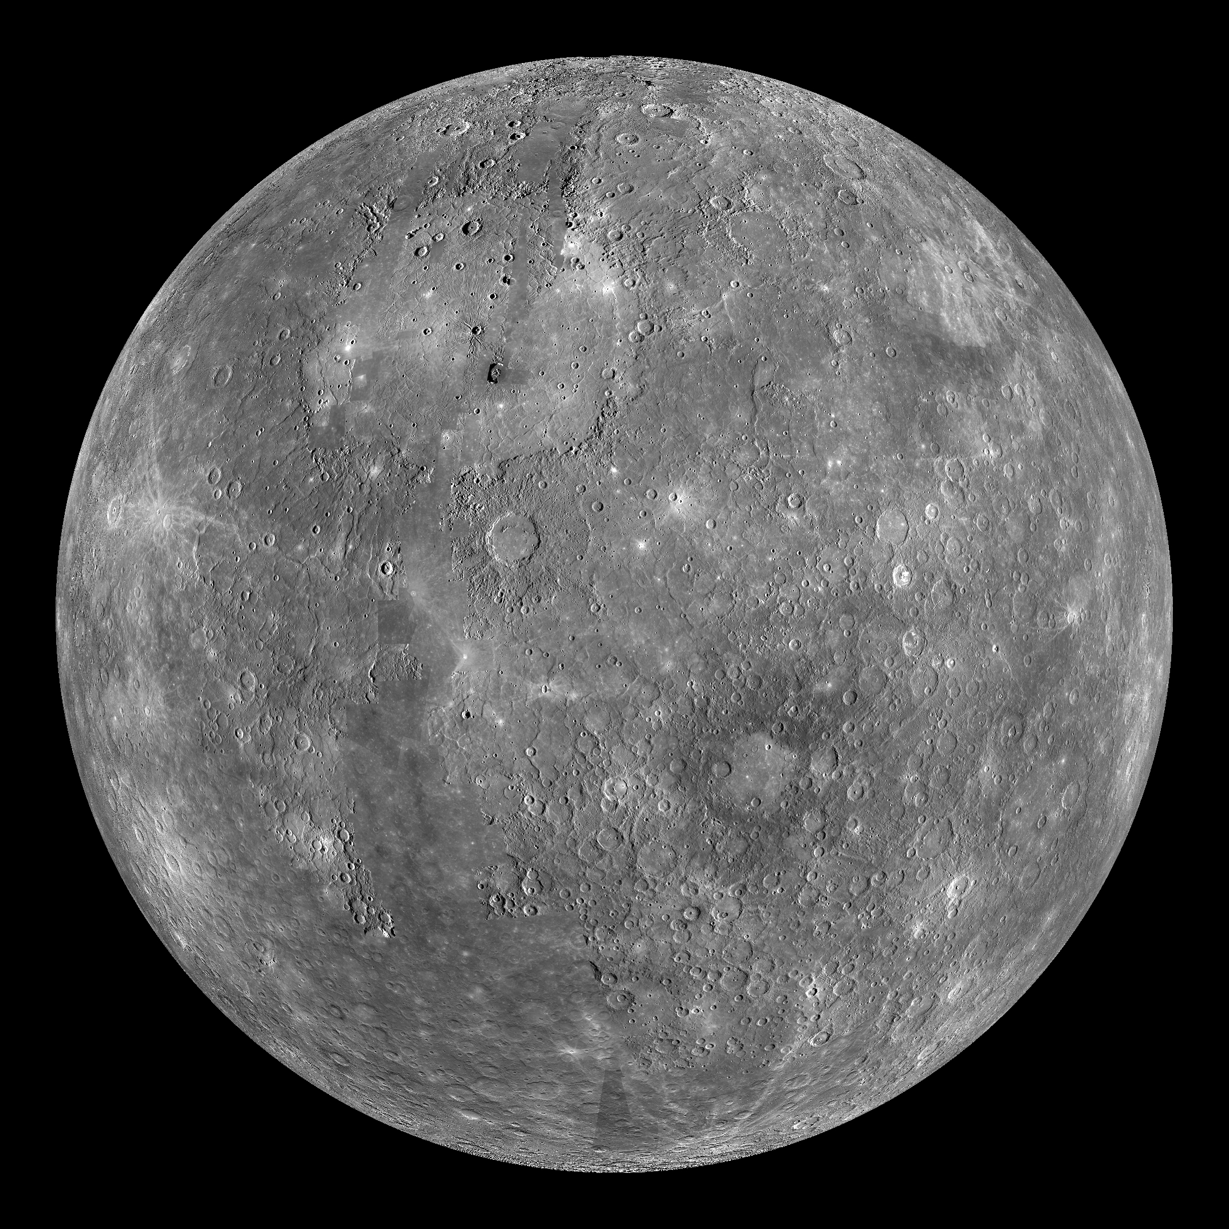
Mercury

Slide 10
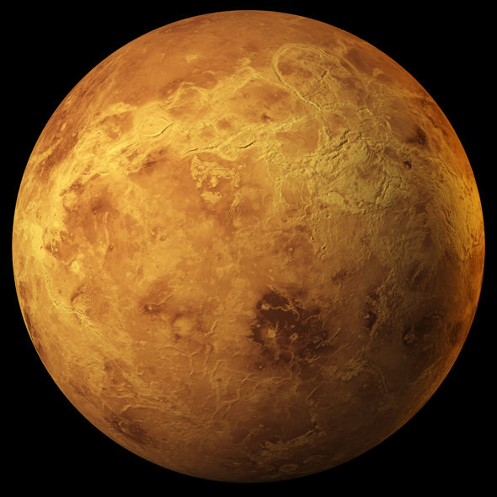
Venus

Slide 11
The earth

Slide 12
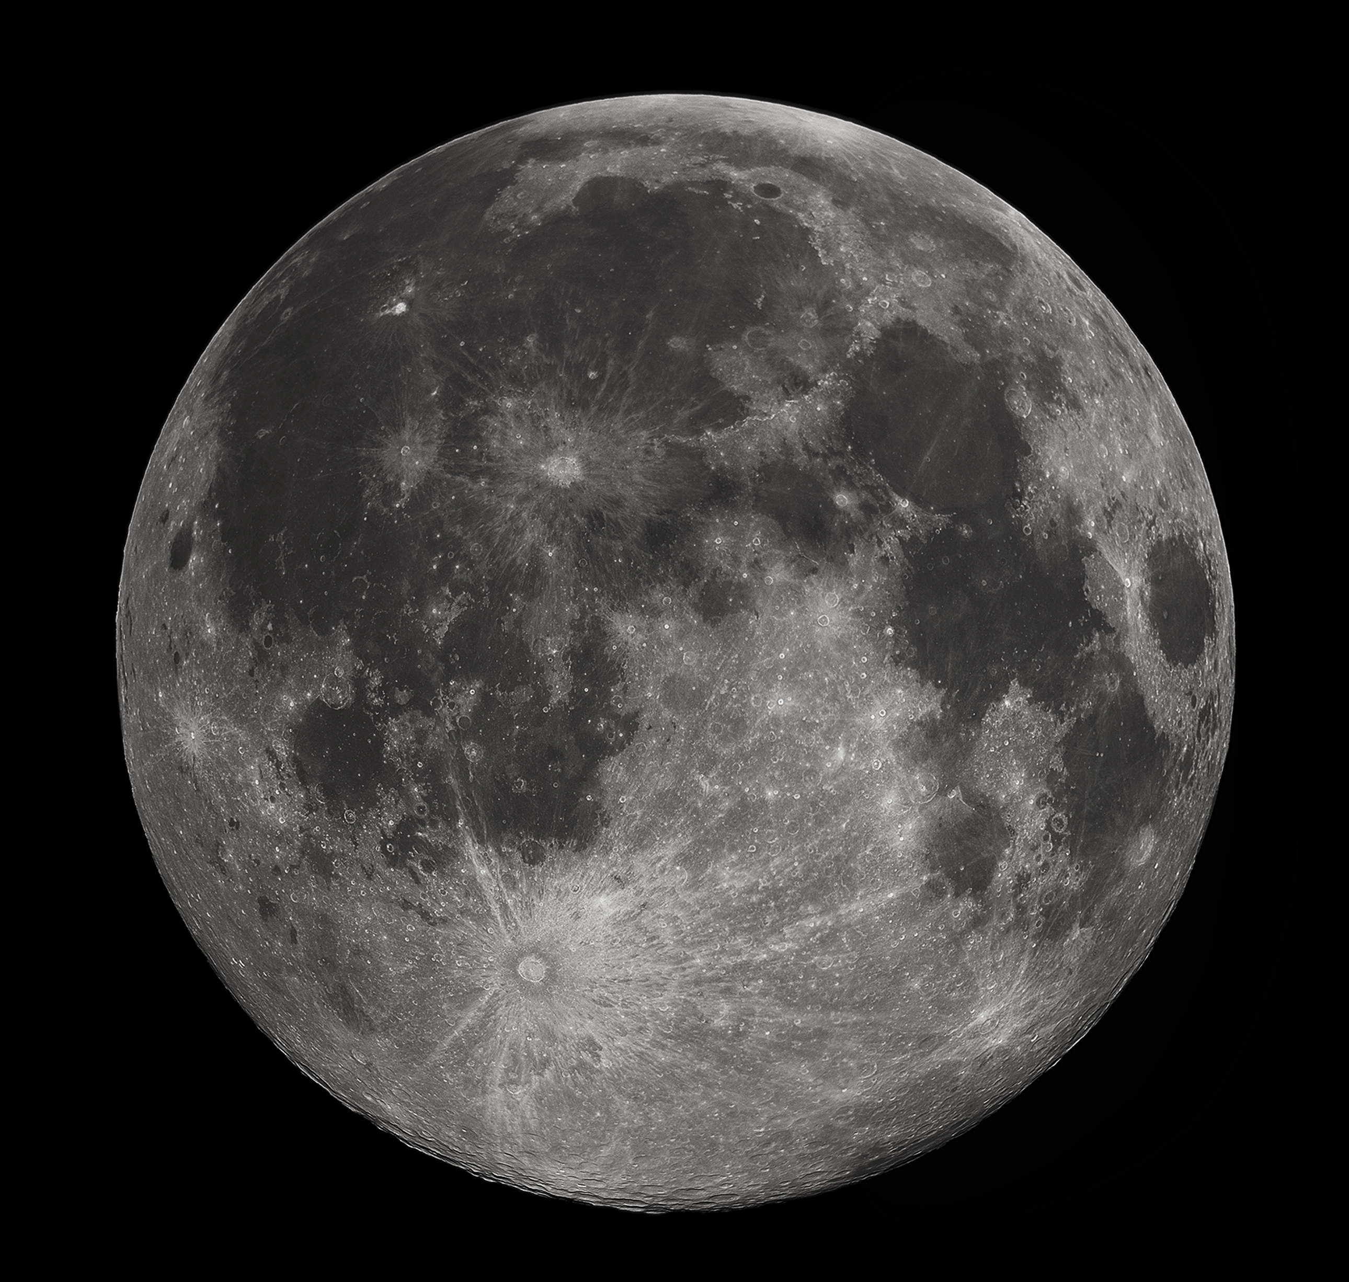
The moon
The Earth’s natural satellite

Slide 13
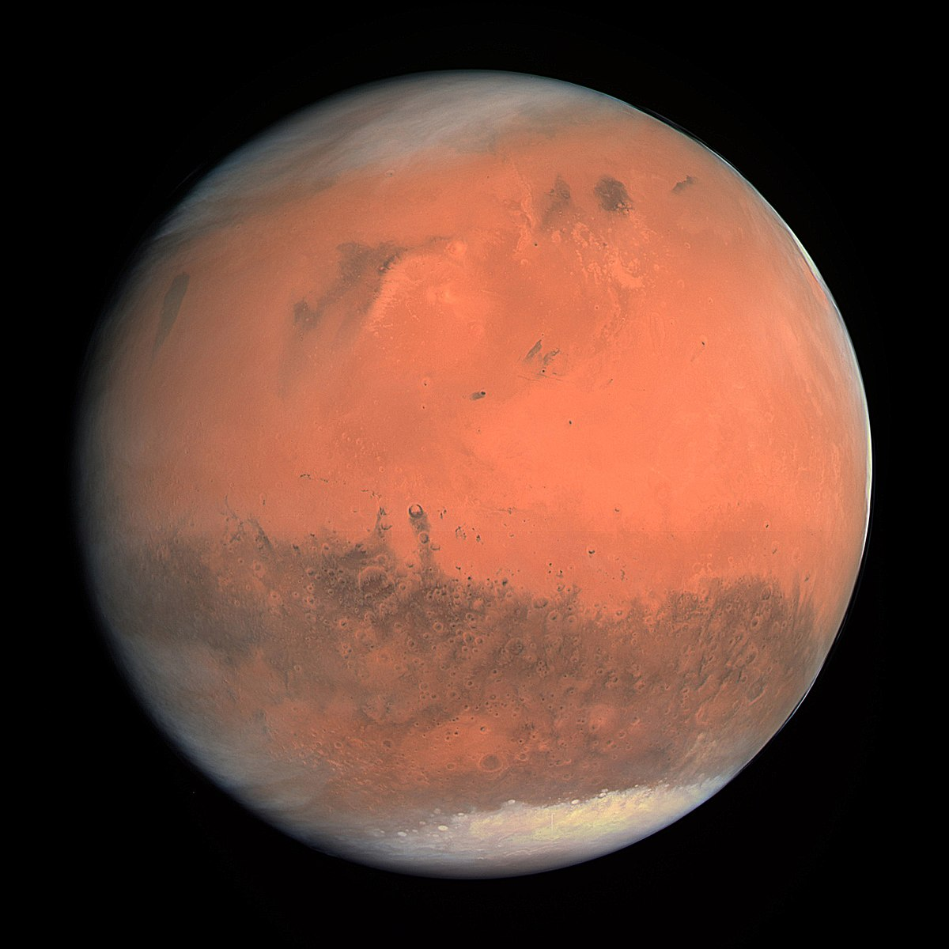
Mars

Slide 14
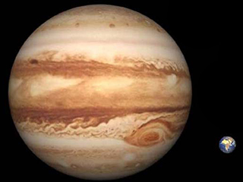
Jupiter

Slide 15
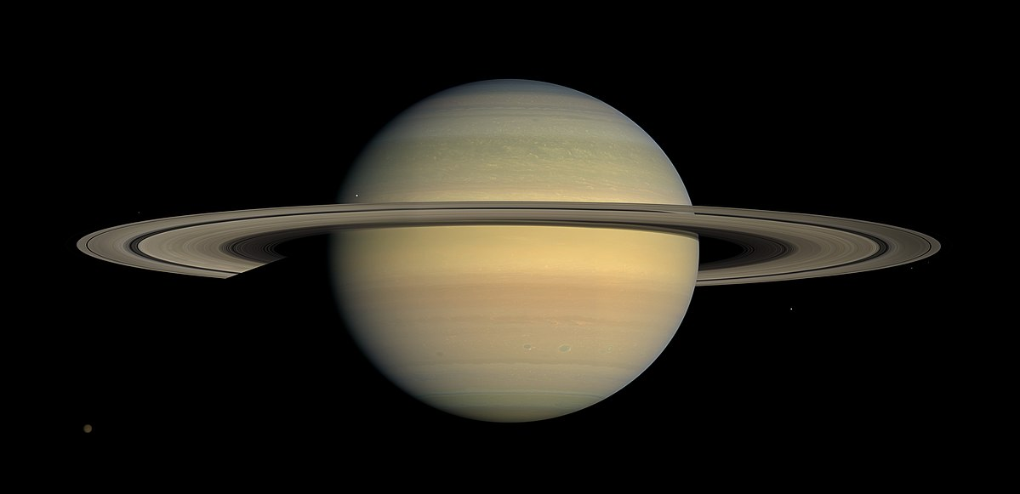
Saturn

Slide 16
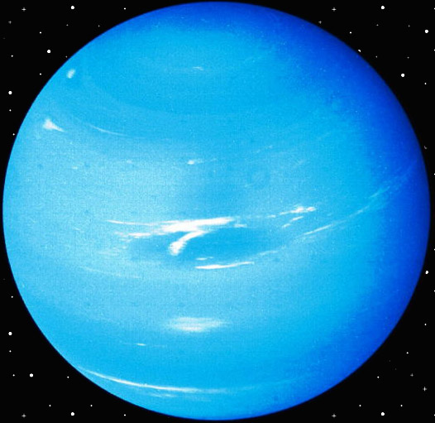
Uranus

Slide 17
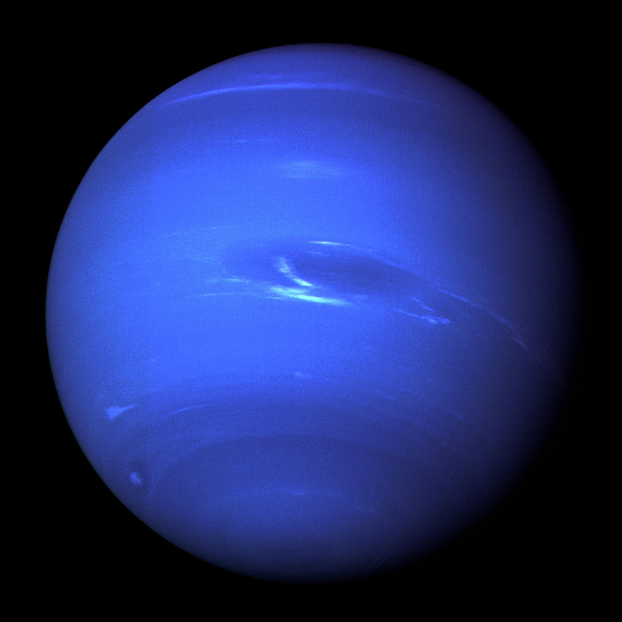
Neptune

Slide 18
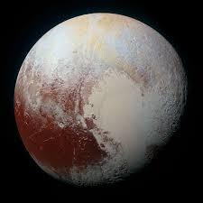
Pluto

Slide 19
The surface of planets
crater
valley
mountain
plain
rock

Slide 20
WHAT CAN MILO FIND?
WHO CAN MILO MEET?
an astronaut
an alien
a robot
a rocket
a spaceship

Slide 21
MILO’s story
Some actions
land
take off
meet
find
lift
travel
drive
move

